Slide 1
Presentation ON
RESTAURANT MANAGEMENT SYSTEM

Slide 2
Presented to: Ayesha Siddika Assistant Professor & Co-ordinator Department of CSE
Presented by: Md Pias Hossain- 163432563
Md Rasel Hossain- 163432521

Slide 3
WELCOME
TO
OUR PRESENTATION

Slide 4
Introduction
Online Restaurant Management System" is a web application. This system is developed to automate day by day activity of a restaurant.
Restaurant is a kind of business that serves people all over the world with readymade food. This system is developed to provide service facility to restaurant and also to the customer.

Slide 5
BACKGROUND HISTORY
Restaurant management system is the system for manage the restaurant business. The main point of developing this system is to help restaurant administrator manage the restaurant business and help customer for online ordering and reserve table.
So, restaurant management system will develop to help the restaurant administrator to manage restaurant management and for customer make their online ordering and reservation table.

Slide 6
EXISTING SOFTWARE
The Restaurant Professional Software program is a comprehensive restaurant management tool designed for foodservice management of all types. It is simple to learn and easy to use. This system processes transaction and stores the resulting data. Reports will be generated from these data which help the manager to make appropriate business decisions for the restaurant. For example, knowing the number of customers for a particular time interval, the manager can decide whether more waiters and chefs are required. Restaurant Software Systems are essential to the successful operation of most foodservice establishments because they allow the business to track transactions in real-time.

Slide 7
REQUIREMENT ANALYSIS
System-Level Data Recovery
Application-Level Data Recovery
Application Data Availability
Multi-Level Data Security
Scalability: Users, Transactions, Data
DBMS Autonomics and Process Automation

Slide 8
Hardware & Software requirement
Software requirement:
Operating System
Xampp,Wamp
MySQL
Internet Browser
Hardware Requirement:
Processor
Memory Space
Monitor
RAM
Others i/o devices

Slide 9
RELATIONAL MODEL
In relational model, the data and relationships are represented by collection of inter-related tables. Each table has a group of column and rows, where column represents attribute and rows represents records.

Slide 10
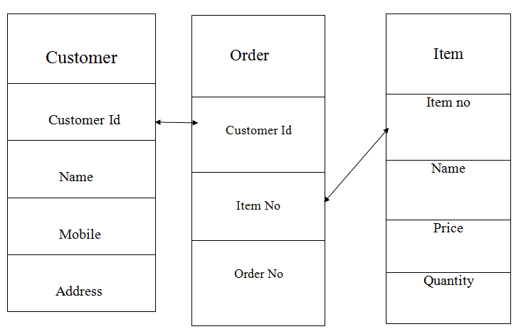
Relation with Customer , Order and Item Table:

Slide 11
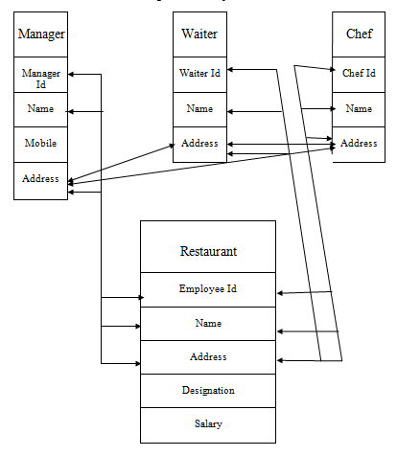
Relation with Manager,Waiter,Chef and Restaurant:

Slide 12
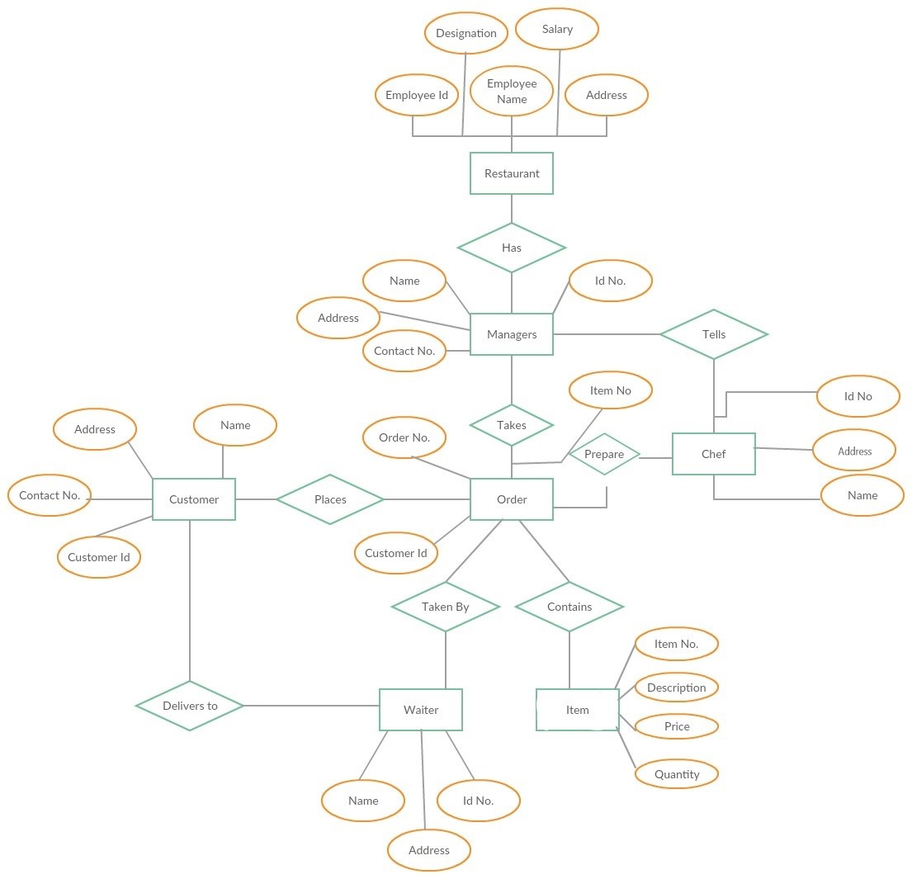
E-R DIAGRAM

Slide 13
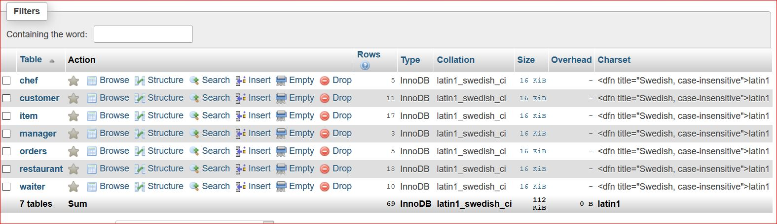
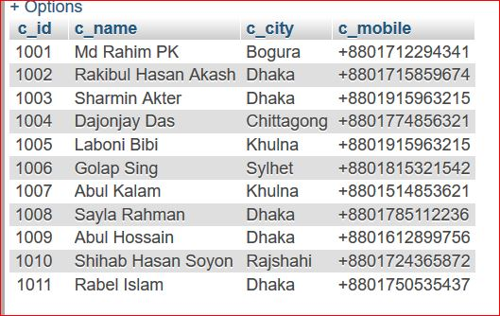
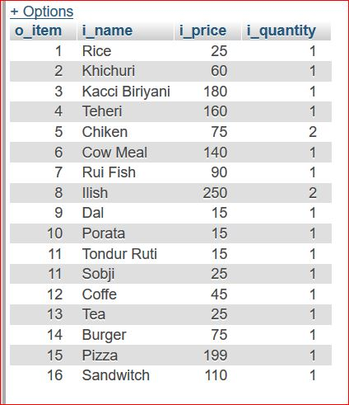
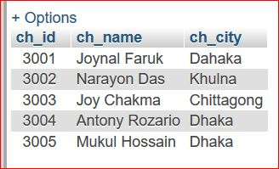
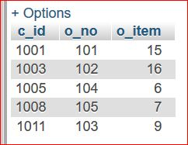
TABLE CREATE WITH VALUE

Slide 14
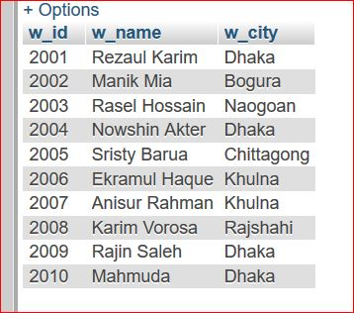
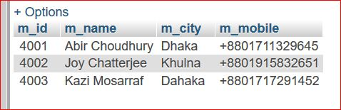
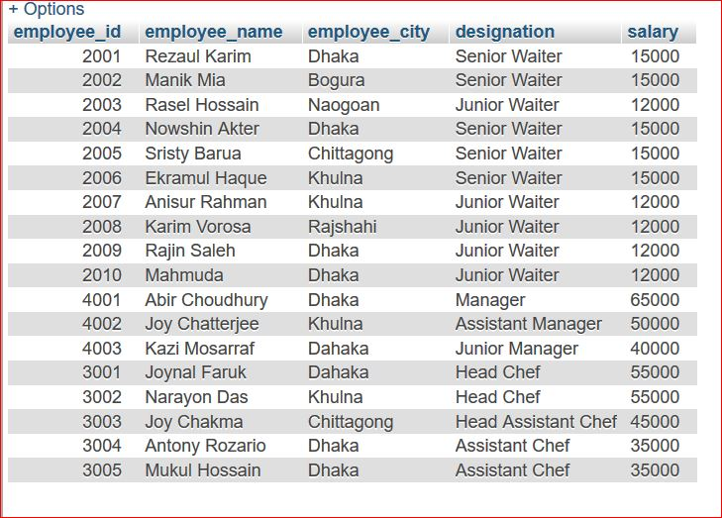

Slide 15
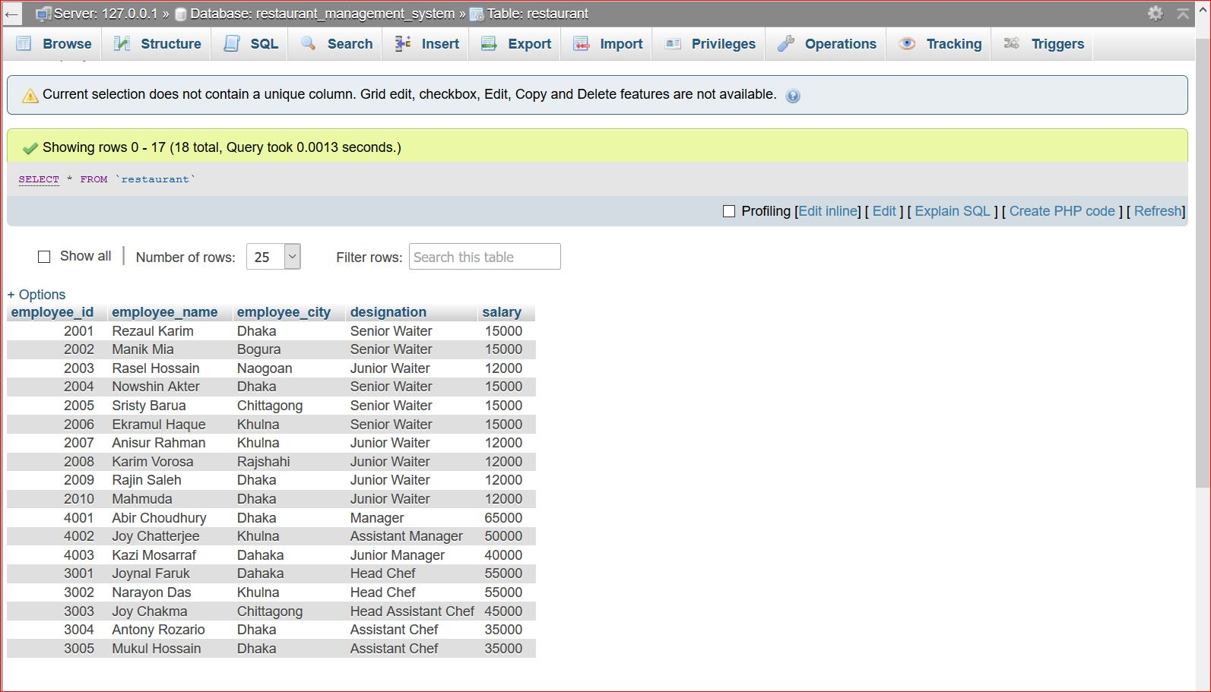
SNAPSHOTS WITH QUERY AND OUTPUTS
Select Query and Output:

Slide 16
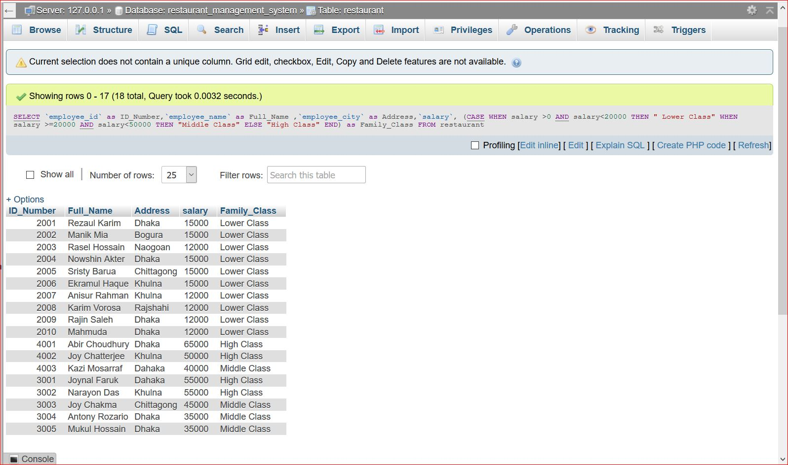
Case Query and Output:

Slide 17
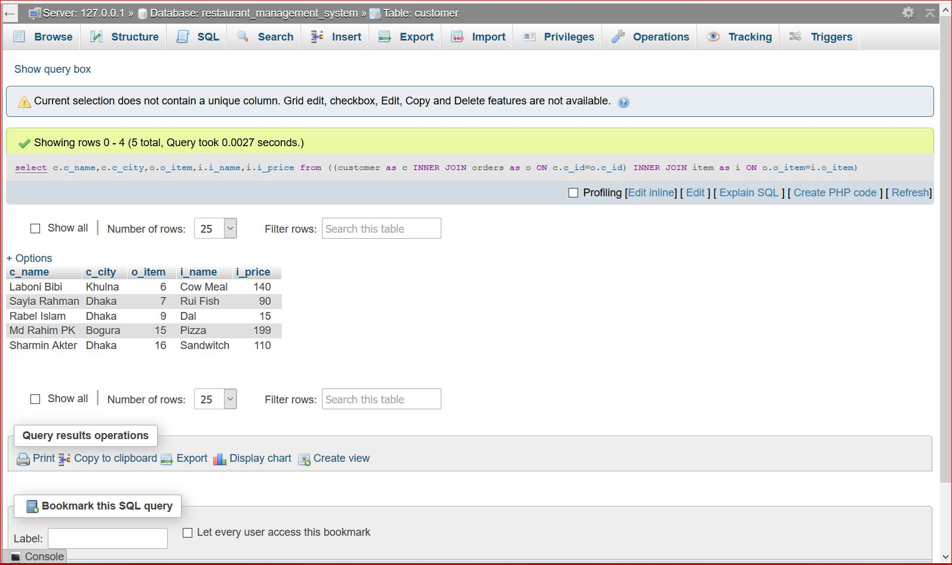
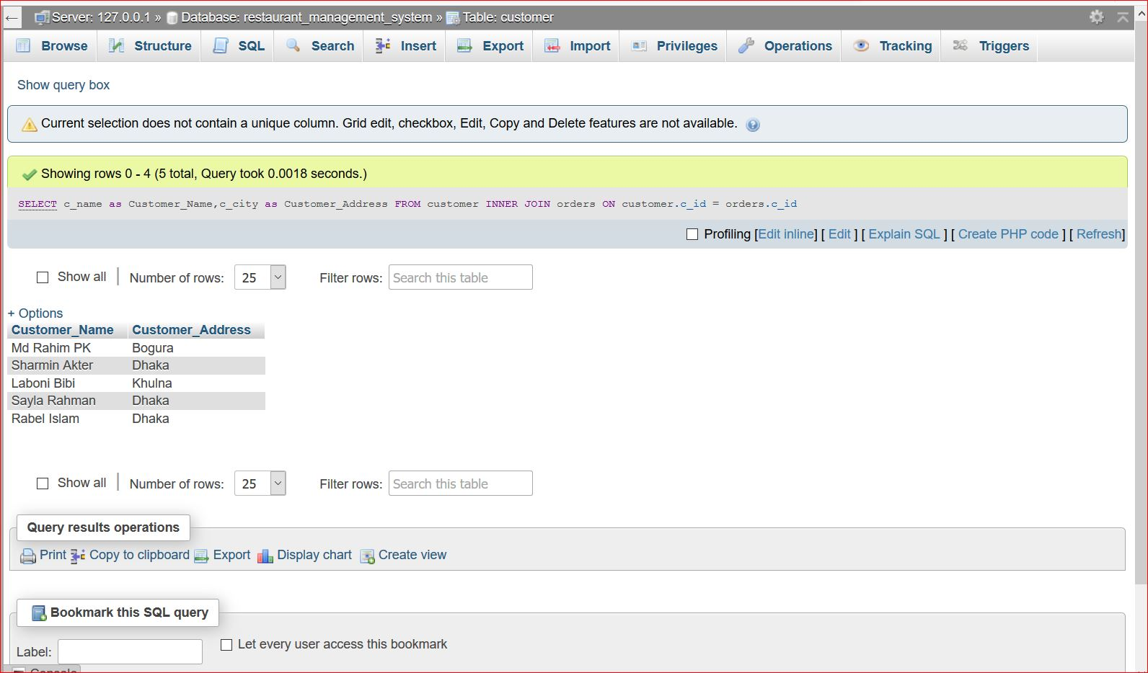
Inner Join Three Table with Rename and Output:

Slide 18
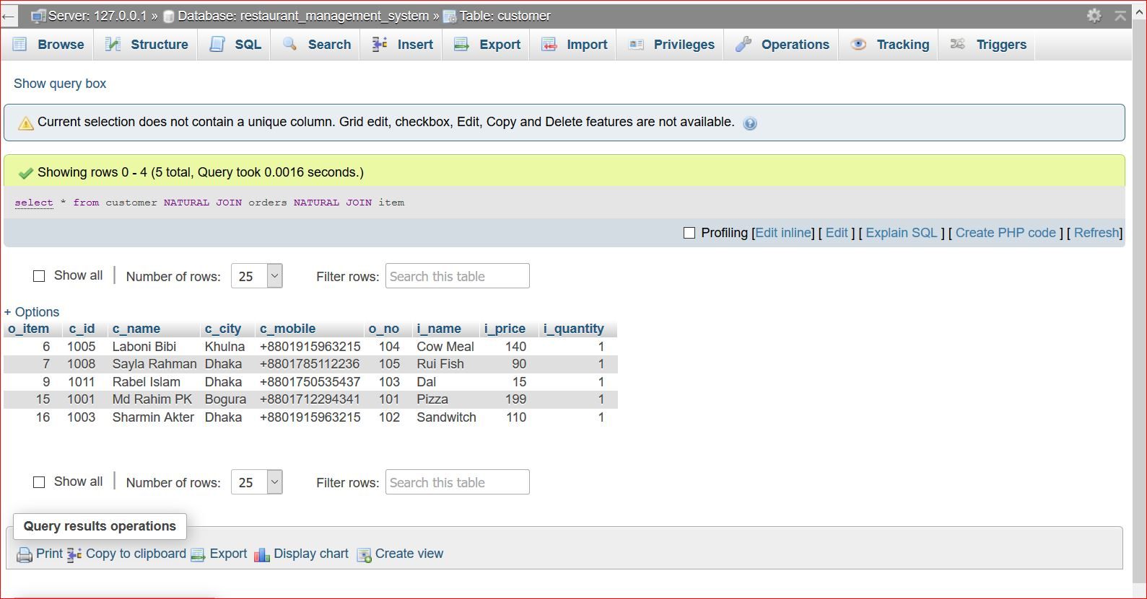
Natural Join and Output:

Slide 19
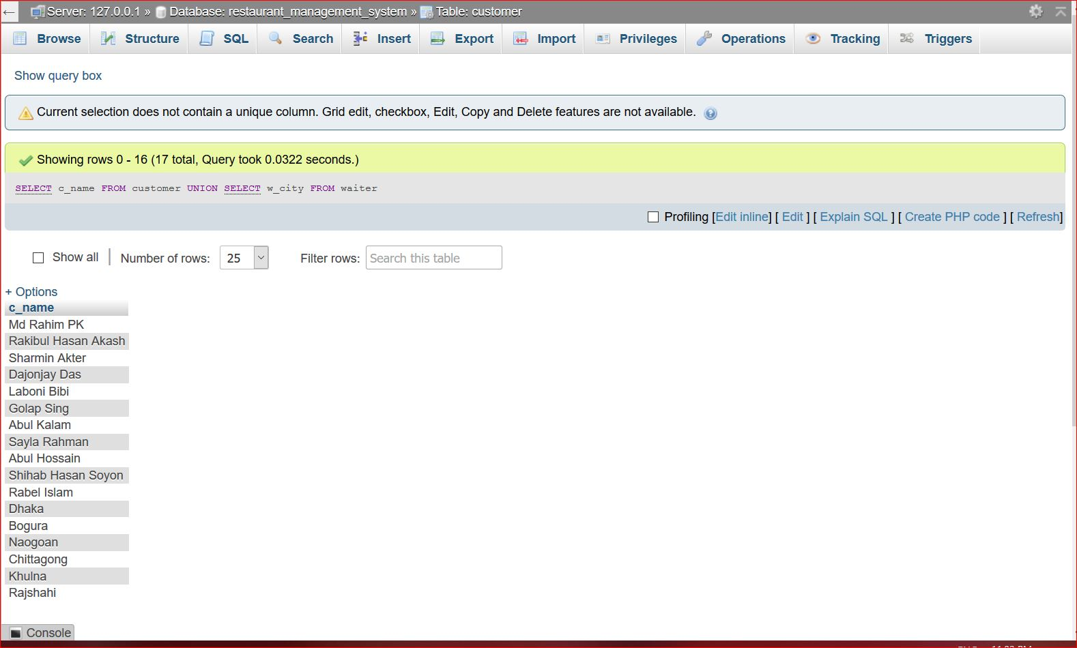
Union and Output:

Slide 20
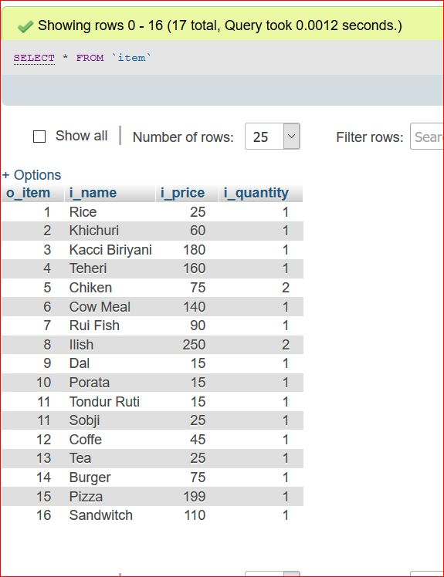
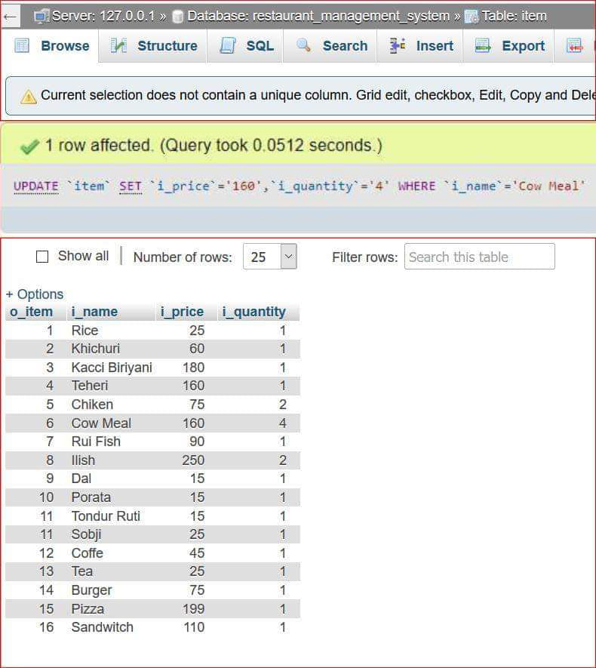
Update Query and Output:
Before
After

Slide 21
ADVANTAGES
It increases operational efficiency.
It is designed to help you cost your recipes and track inventory saving your Money and Time .
It is also designed for inventory control, menu, recipe and costing
It increases the security.
It avoids paper work.
It is Simple to learn and easy to use.
It is portable.

Slide 22
DISADVANTAGES
We have sure that most food businesses need a lot of employees to function properly and smoothly with the majority of those workers being low-paid.
User cannot view the booked table in person.
The system limits human interaction.

Slide 23
FUTURE PLAN
First we design front end for the application with attractive look. Project planning is part of Project Management. It is a well-established approach to managing and controlling the introduction of new organizational changes. Projects are finite in length, usually one-time pieces of work involving a number of activities that must be completed within a given time frame, and often on a fixed budget.

Slide 24
CONCLUSION
The Restaurant Management System helps the restaurant manager to manage the restaurant more effectively and efficiently by computerizing ordering, billing and inventory control. The system processes transaction and stores the resulting data. Reports will be generated from these data which help the manager to make appropriate business decisions for the restaurant.

Slide 25


